Slide 1
GameBoard
All-in-one Arcade Games Website
Aleksandra Trifonova | Haemin Lee | Angelica Flores | Alexis Siguenza | Ian Iskra

Slide 2
Table of Contents
Introduction/Overview
Frameworks and Documentation
React
Phaser.io
Features
Home Page, Profiles, Games
Arcade Games
Challenges + Lessons

Slide 3
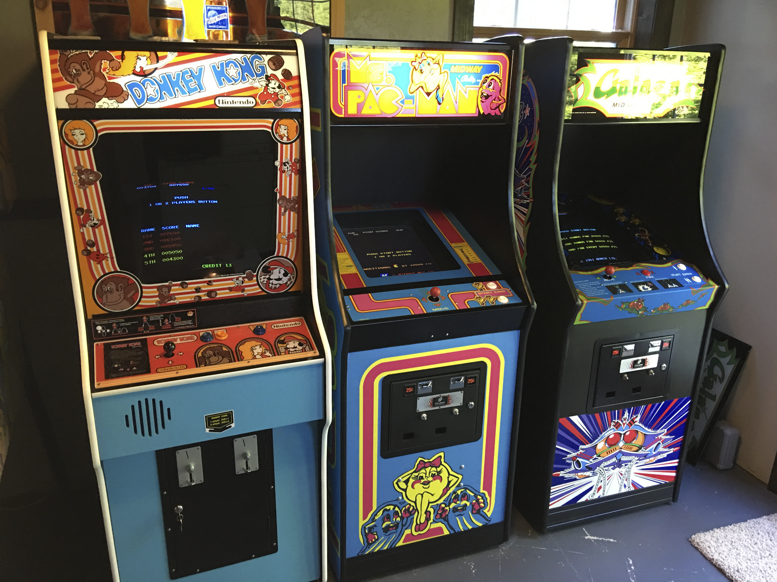
Introduction
Classic Arcade website which hosts a variety of classic games such as Pac-Man, Space Invaders, and Snake. These games are all simple in their gameplay and are able to be enjoyed by a variety of young and old people alike.
There are two portions to our project, which is the web page which was developed in react and bootstrap and Material UI/IO. The arcade games themselves were developed in Phaser, javascript and HTML.
For version control we used Github in order to keep track of the games and have easy access to prior version and be able to merge all of the parts that were worked on into one final project.

Slide 4

Framework : React.js
Why We Chose React?
Newer emerging technology that’s commonly used in front-end applications by industry.
This is similar to React Native which we could use in app-development.
Gives us a stronger foundation to learn other secondary uses.
Can allow us to be more marketable in the job field.
Easy to learn, information availability regarding documentation.
It has bootstrap capability, @material-ui/icons (helpful libraries).
npx create-react-app website
npx install
npm install @material-ui/icons
npm install --save react-router-dom
npm install react-bootstrap bootstrap

Slide 5


Framework: Phaser.io
Why we chose Phaser.io?
Fast rendering
Supported by desktop and mobile
Many built in features like collision and physics
Beginner friendly tutorials
Allows development of fully fledged games without having prior knowledge
Phaser has three main functions that are vital to the life cycle; preload, create, and update.

Slide 6
Documentation
Official Docs
Community Resources
https://reactjs.org/docs/getting-started.html
React.js Official Documentation
https://reactjs.org/tutorial/tutorial.html
React.js Tutorial
https://photonstorm.github.io/phaser3-docs/
Phaser Official Documentation
http://phaser.io/learn
Phaser Tutorials and Examples
https://www.geeksforgeeks.org/bubble-sort/
Snake - used to check which space is occupied by the snake (how you die)
https://medium.com/@josephcardillo/using-math-random-in-javascript-c49eff920b11
Snake - used this function to get the food to be placed in random places on map
https://phaser.discourse.group/
Phaser community forums
https://www.spriters-resource.com/
Game sprite assets

Slide 7

FEATURES

Slide 8
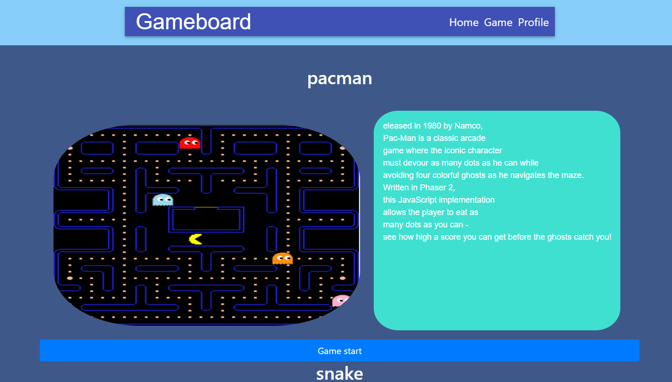
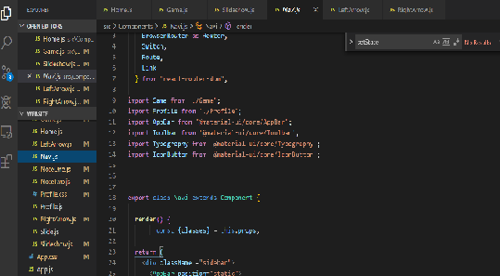
Done by haemin, made Navigation, Home, Game Components, etc
Used Material UI and Icons to make Navi Components
Used bootstrap in card one and two, try to understand how to use bootstrap in react.js
Used youtube and textbook to make slideshow and search information.
Add some css in app.css to change some parts.

Slide 9
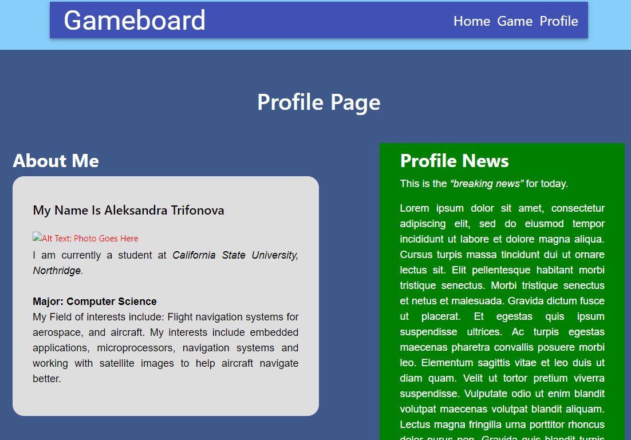
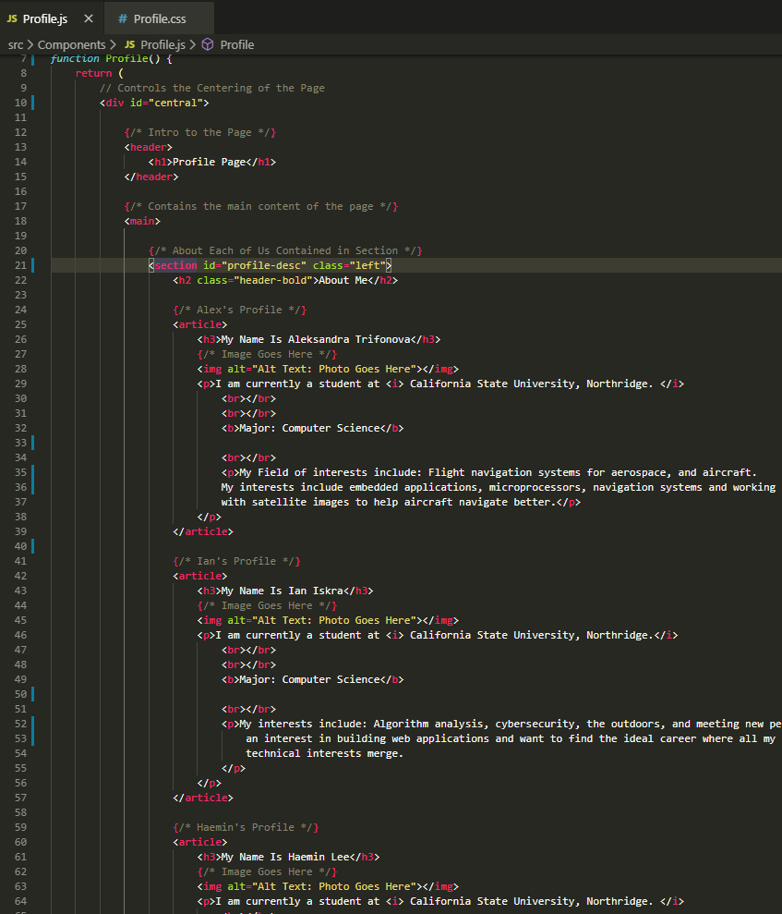
Profile Page
Done by Ian Iskra, worked on the front end to display the HTML5 semantics within a React.js framework.
The above navigation is carried across the website and Profile link will take you to this page.
Semantics include: <main> contains the main content, <section> which contains <article> of each user profile, and <aside> which contains the News.
Additionally, a class of .left and .right are applied to float in respective layouts.
Within <article> border-radius style is applied for rounded edges and contains the information about user, divided by strategic headers (h2, h3,), paragraphs and appropriate line breaks (<br>).

Slide 10
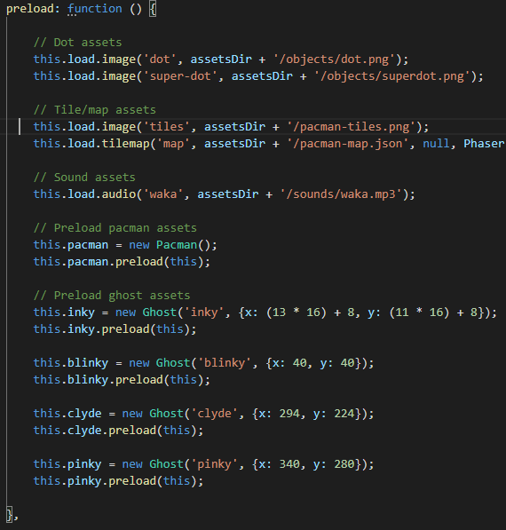
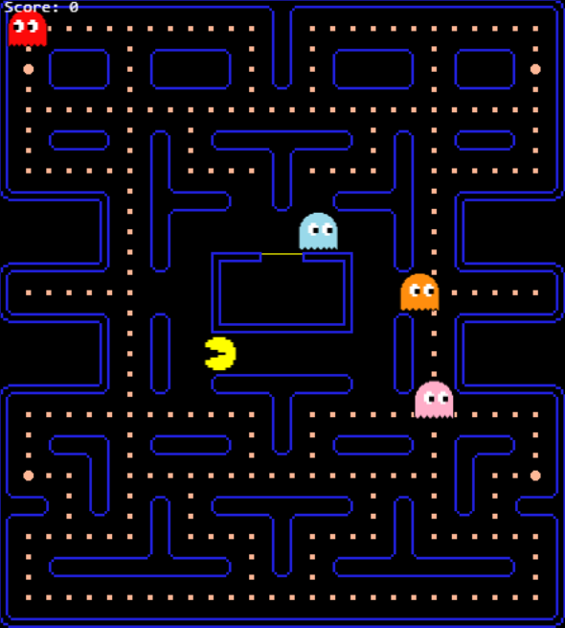

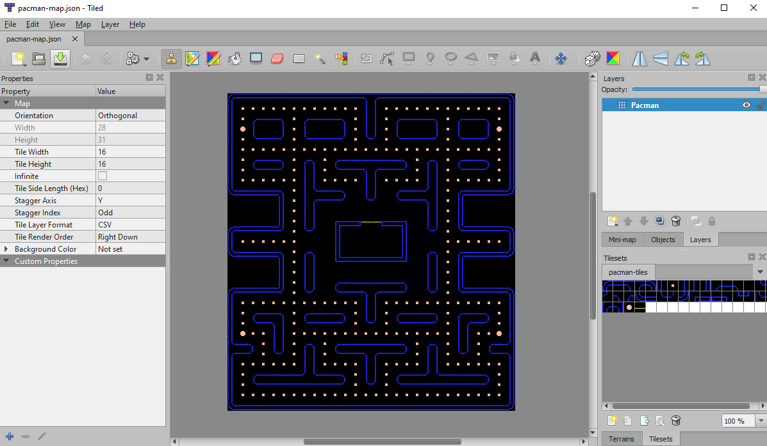

Pac-Man Game
Written in Phaser 2 framework
Three major parts
Scene, Map, Sprites
Helpful Functionality
Asset handling
Keyboard control
Game physics
Velocity & collision
Pac-Man
Control with arrow keys
Eat dots and kill ghosts
Ghosts
Maze path-finding
“Afraid” run-away mode
Dots
Super dots mode
Infinite respawn
High score count

Slide 11
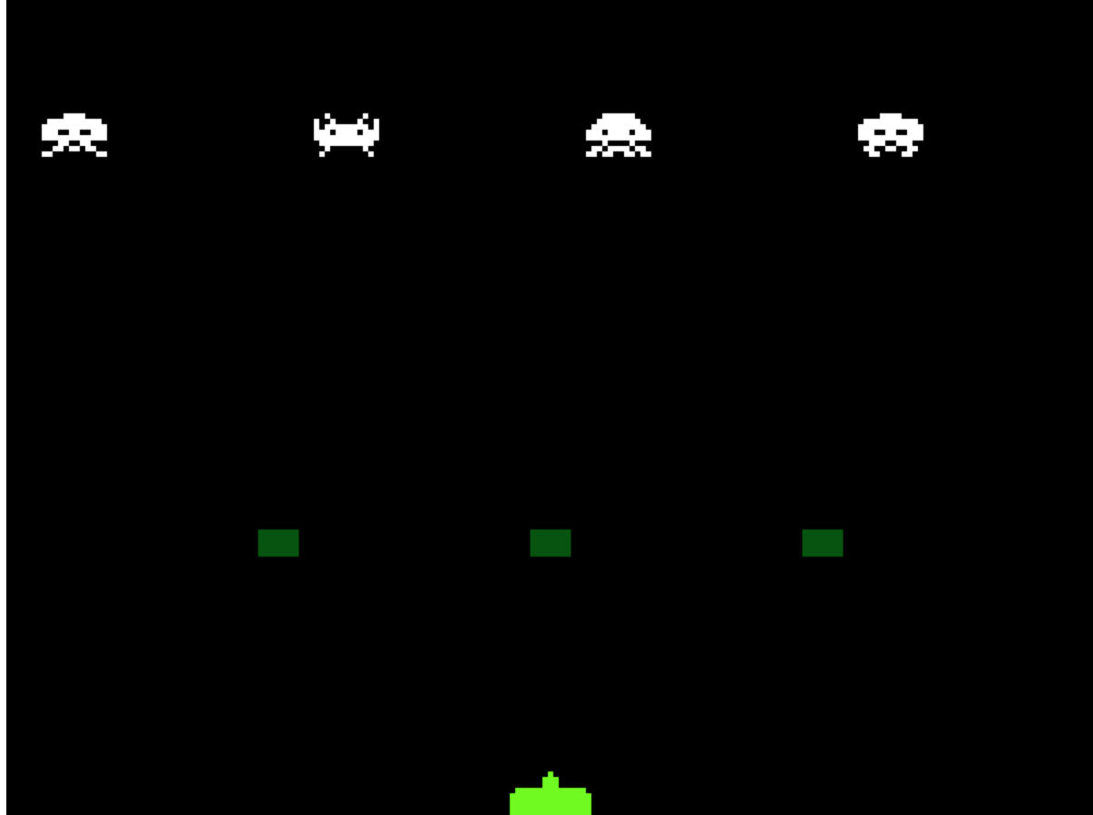
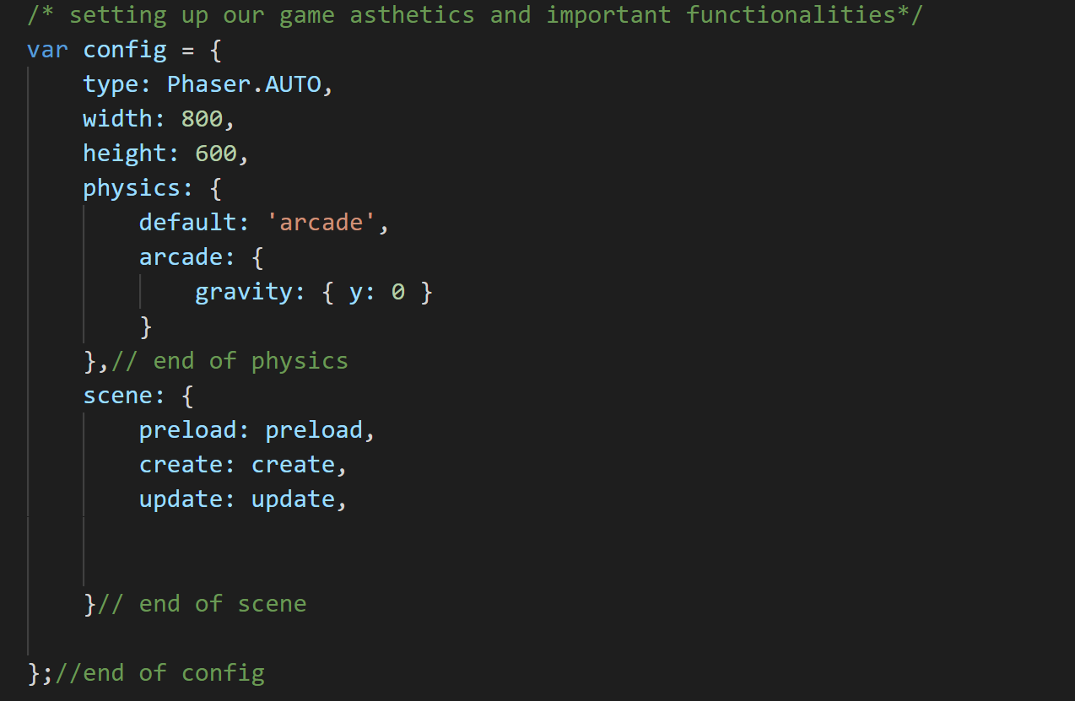

Space Invaders Game
Written in Phaser,js version 3.
Main components in the code:
Configuration () default code given by Phaser 3.
Preload() assets load
Create() positions for the sprites
Update(): updates game every frame
Many Global Variables *one very important shown
Other components:
shootBullet() used velocity to move bullets -900 px up
alienShoot() same as shootBullet only 900 px to move down
randomAlien() makes aliens shoot randomly
killIfOffscreen() so bullets won’t bounce back
Notes:
Configuration () default code given by Phaser 3.
Preload() assets load
Create() positions for the sprites
Set the left and right key
loads up to 30 bullets
Update(): updates game every frame
Checked if keyboard was pressed
Set spacebar to shoot bullets
Many overlaps for collided sprites
Alien Time interval to shoot every 5 seconds
Many Global Variables *one very important shown

Slide 12
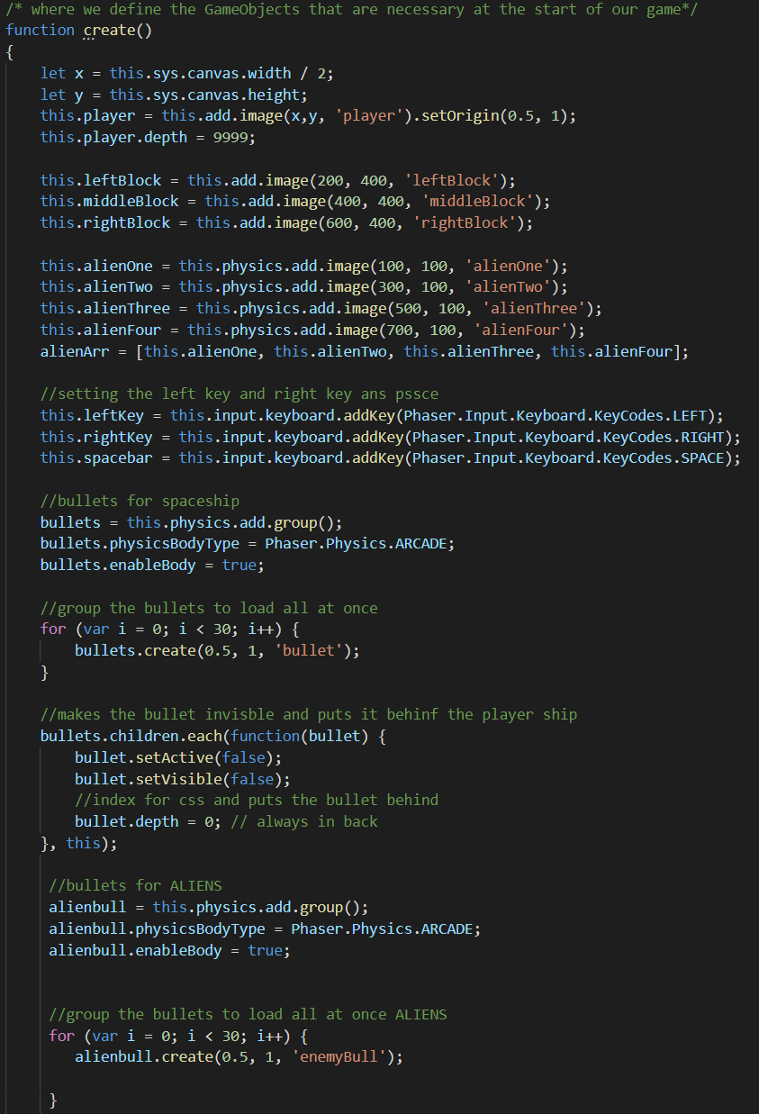
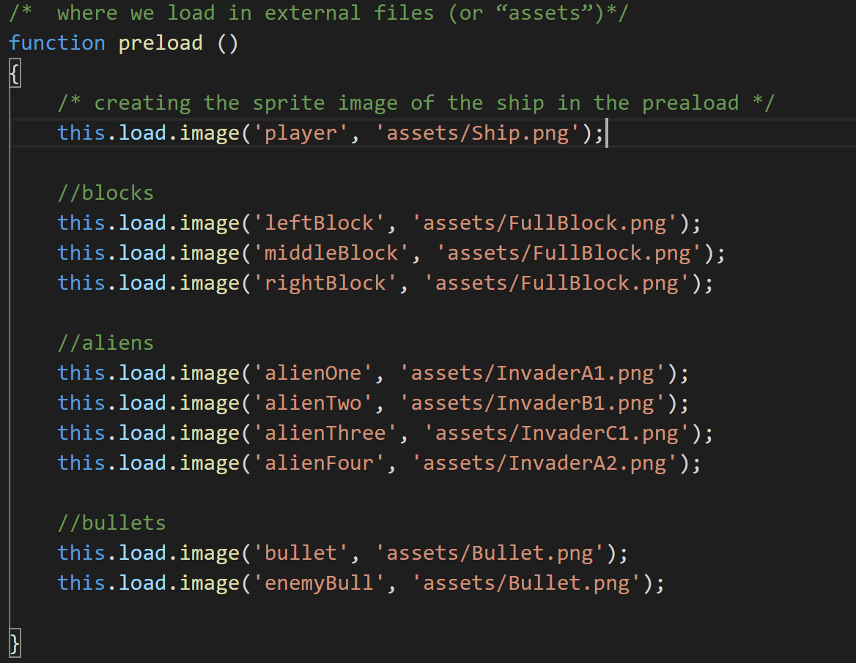
Space Invaders Create()
Space Invaders Preload()

Slide 13
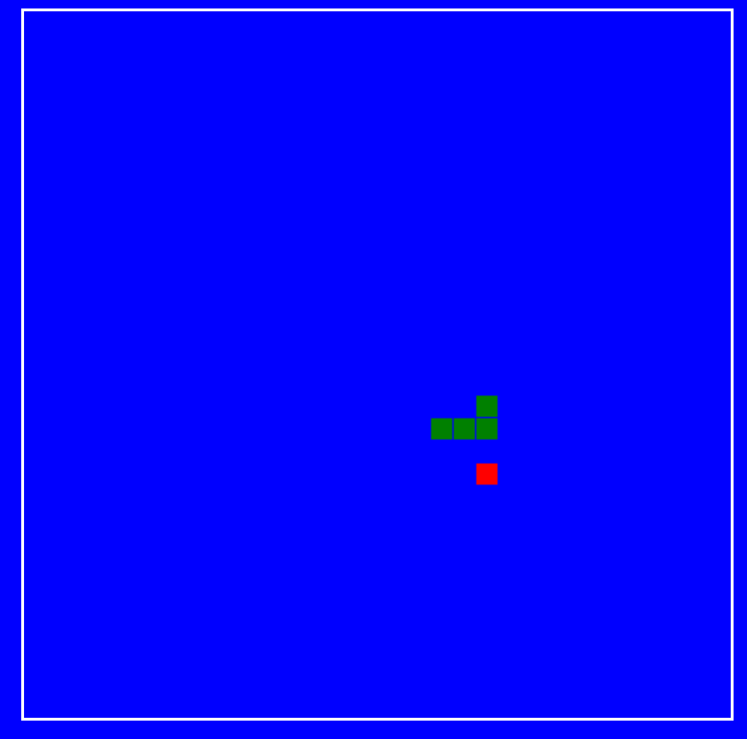
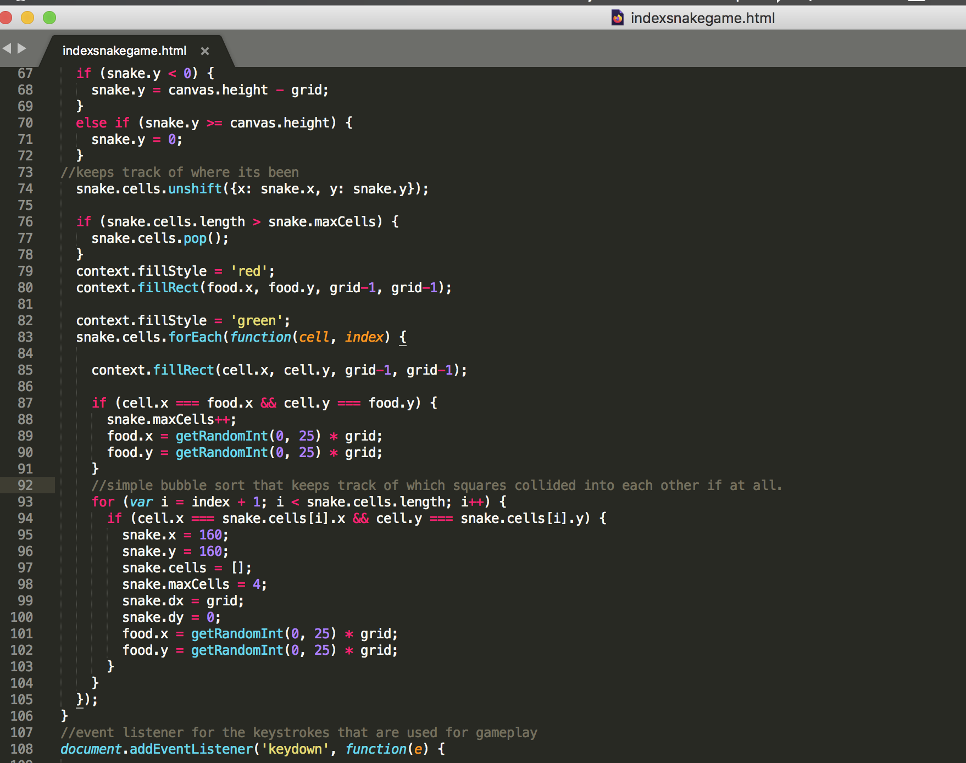
Snake Game
Done by Aleks, snake game developed in html and javascript
Main function eat the food, grow the snake
If the snake catches up to itself it dies (you lose)
The reason the game was developed in html and javascript was because we wanted to make the comparison between making a game with phaser and in pure javascript and html to showcase that games can be developed in javascript without a framework and still render properly across multiple platforms tested in (safari, firefox, and chrome).
Food
Made using math.random function and a bound checker to create the food and make sure the snake can eat the food.
The part of the code displayed here are two of the main components
Keeping track of where the snake is and making sure it isn’t backtracking on itself.
Using a bubble sort in order to keep track of which squares have collided into each other.
Control with arrow keys
Automatic restart when you die.

Slide 14

Challenges
Integrating Phaser with React
Both have a steep learning curve
DOM (React) vs. Canvas (Phaser)
Proper Github etiquette and version control
Keeping track of old versions, which worked and which didn’t and proper pull and push commands (everyone had a different machine and was using git in a different way)
Variable scope in Javascript
Dynamic objects and states
components [React], scenes [Phaser]
Framework Abstraction
Phaser does a lot of behind the scenes work that makes it difficult to understand where certain things are coming from
Can make debugging difficult - Single changes can break code.
NPM dependencies
Install errors, merge conflicts
Material UI
Attempting to make Material UI and icons work with React
Short Time Frame
Learning the frameworks of phaser and react quickly

Slide 15


Slide 16

Lessons
Version control using github
Creating UI components in react
Make as many components as modular as possible
Page Components
Profile, Home, Navigation, Notes
Basic modular Phaser model
Pac Man - Ghosts, Pac-man, dots
Space Invaders - Bullets, Aliens, and the Ship
Snake - Food function (randomly shows up)
Getting the frameworks and developer environment to work in different operating systems

Slide 17
https://siguenza.net:3001/
Live Website
Want to play on your own browser? Go to the link below!

Slide 18


